Slide 1


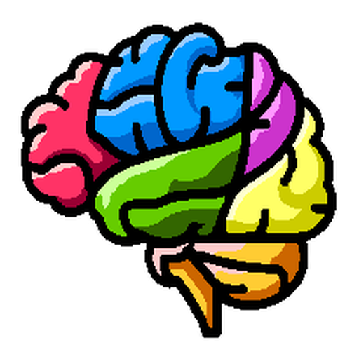
NiChart: Neuro Imaging Chart of AI-based Imaging Biomarkers
Organization for Human Brain Mapping (OHBM) 2024
Notes:
ADD PENNSIVE LOGO

Slide 2
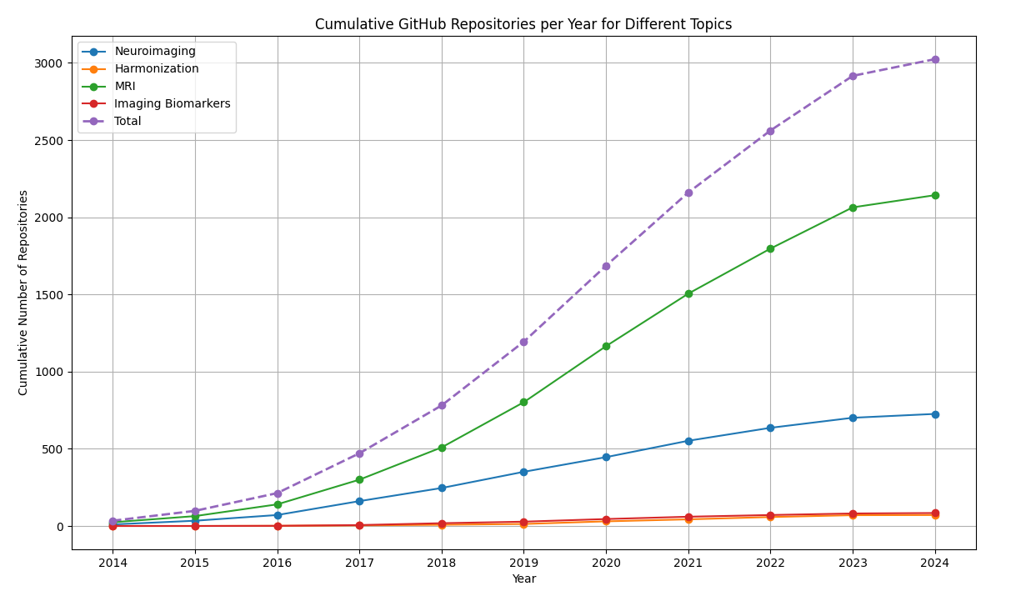
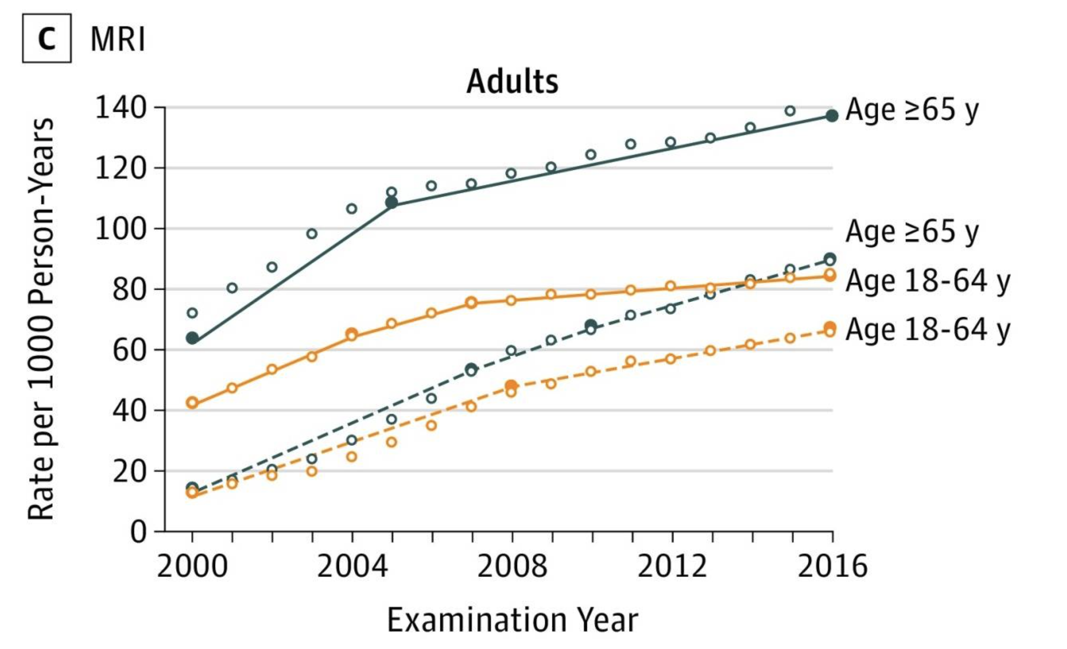
Smith-Bindman R, et al. Trends in Use of Medical Imaging, 2000-2016. JAMA. 2019;322(9):843-856. doi: 10.1001/jama.2019.11456.

Slide 3
Challenges for Researchers and Individual Clinicians in Neuroimaging field
Strategies to overcome the challenges
Collaborative Approach
User-friendly tools
Automation
On-demand computation
Six Major Challenges
Complexity
Understanding advanced techniques
Interpreting Results
Software and Tools
Learning curve
Integration and compatibility
Data Management
Handling large datasets
Data quality and preprocessing
Computational Resources
Access to High-Performance computing
Optimization and efficiency
Technical Support and Collaboration
Need for interdisciplinary collaboration
Technical support
Validation and Reproducibility
Ensuring validity
Reproducibility when using complex pipelines and scripts
Notes:
Audience: Researchers, individual clinicians
Tools that have been developed for Neuro Image analysis are too fragmented and makes analysis difficult and scale,
NiCHart is a project that started to combat the challenges.
Visual element:
Trend chart of GitHub commits
Trend chart of data

Slide 4
Notes:
Audience: Researchers, individual clinicians
Tools that have been developed for Neuro Image analysis are too fragmented and makes analysis difficult and scale,
NiCHart is a project that started to combat the challenges.
Visual element:
Trend chart of GitHub commits
Trend chart of data

Slide 5
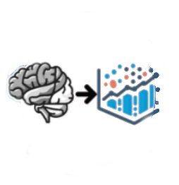
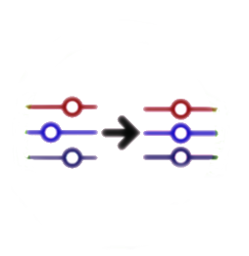
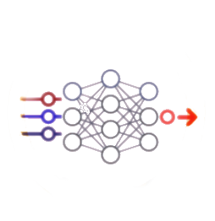

Process multi-modal MRI images
Harmonize to reference data
Apply ML models
Derive individualized biomarkers
“NiChart is an ecosystem of software components enabling constructive integration, statistical harmonization, and ML centric data analysis and studies.”

Slide 6
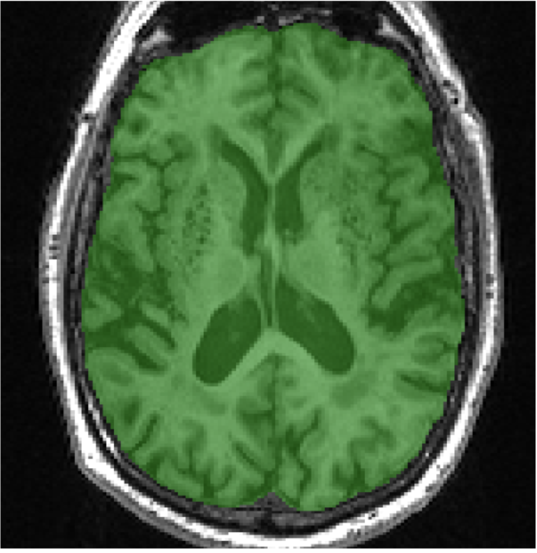
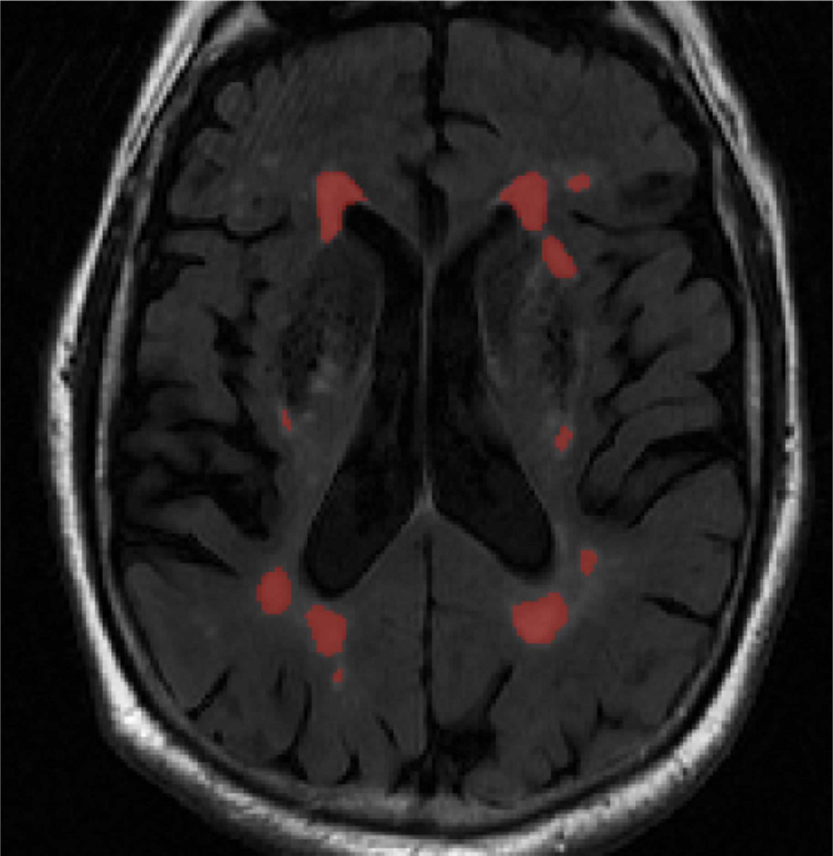
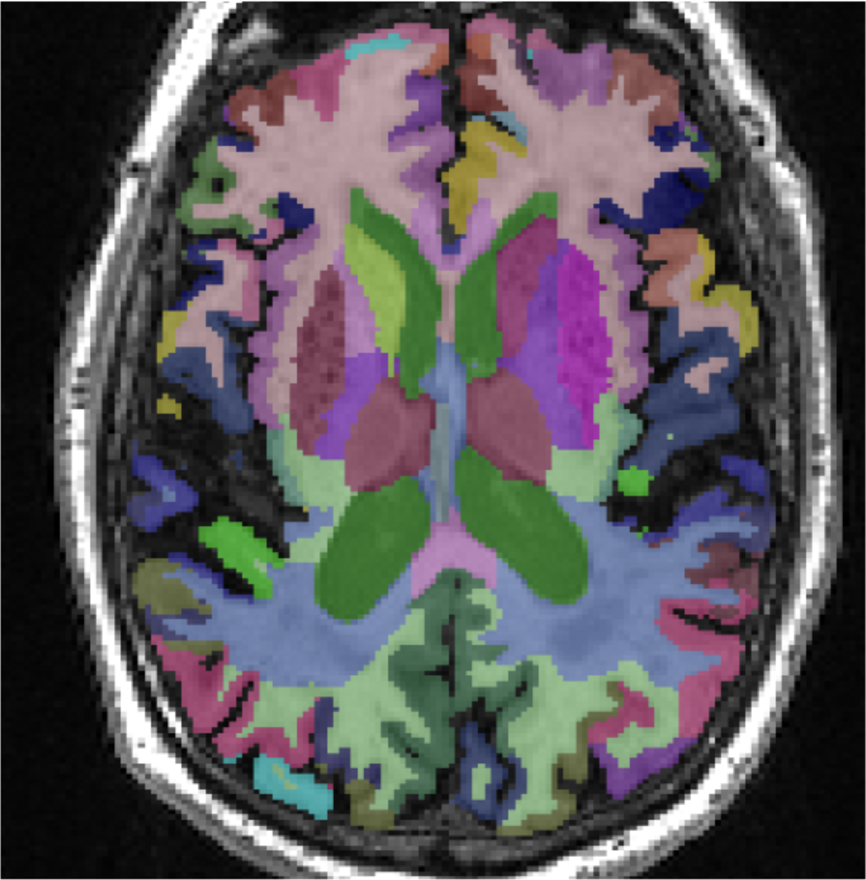
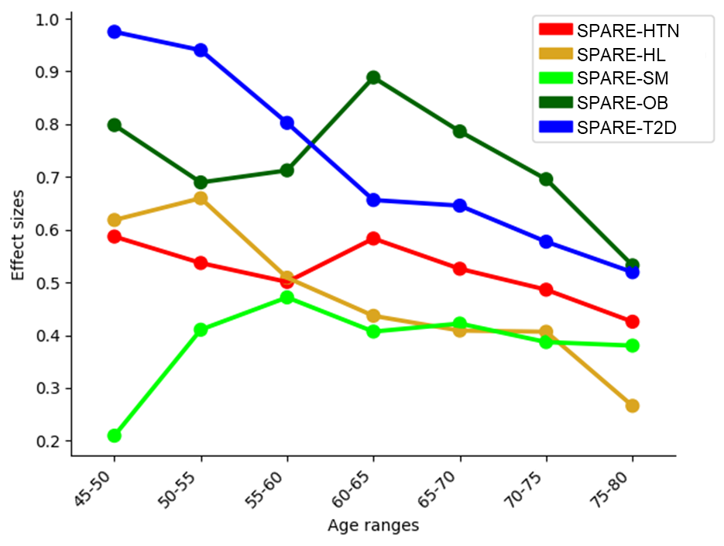
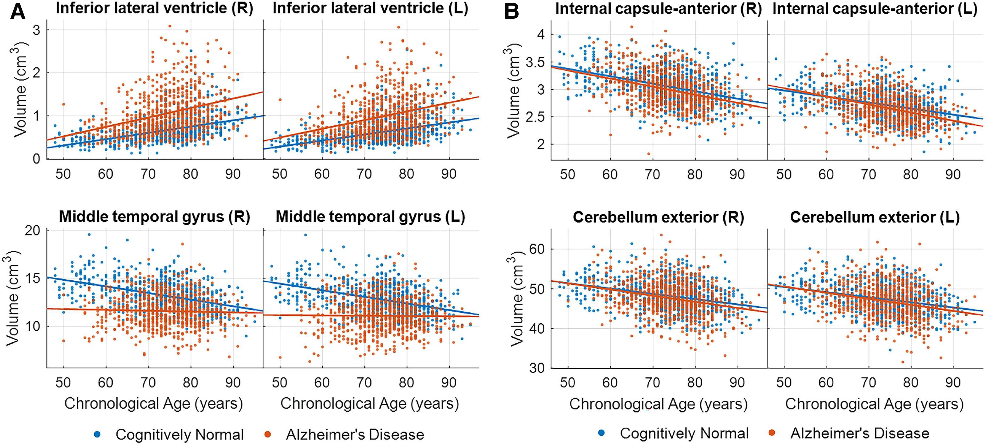
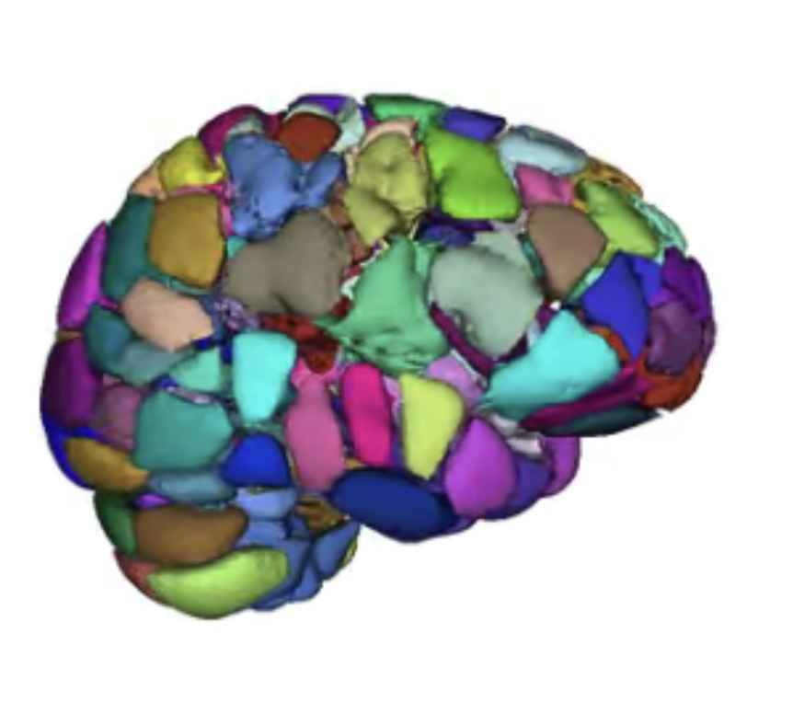
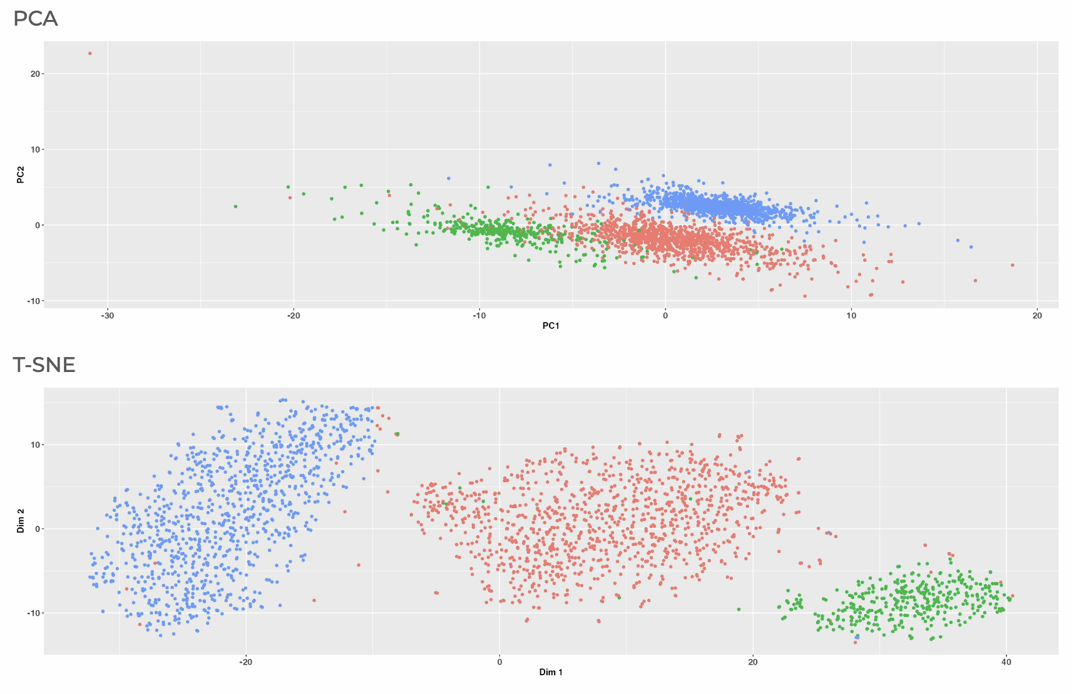
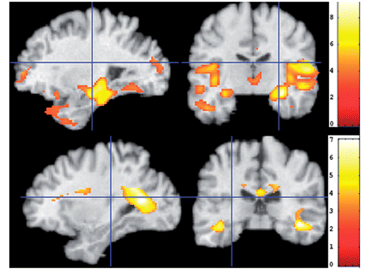
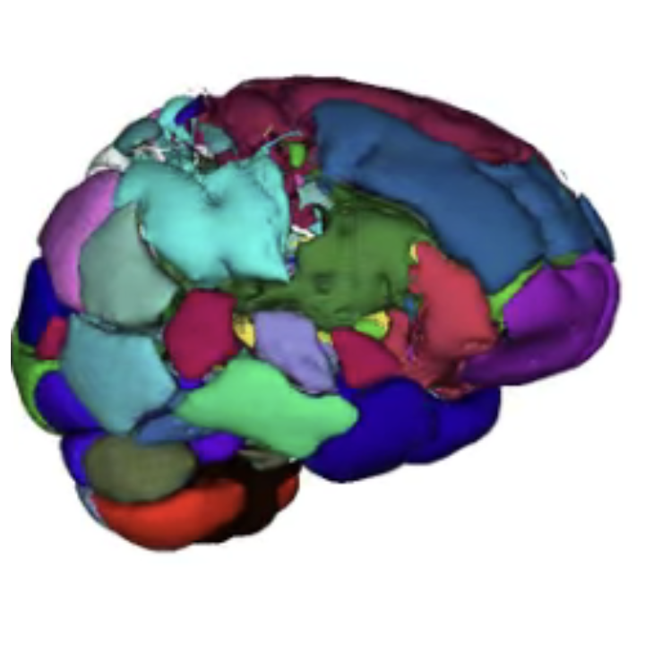
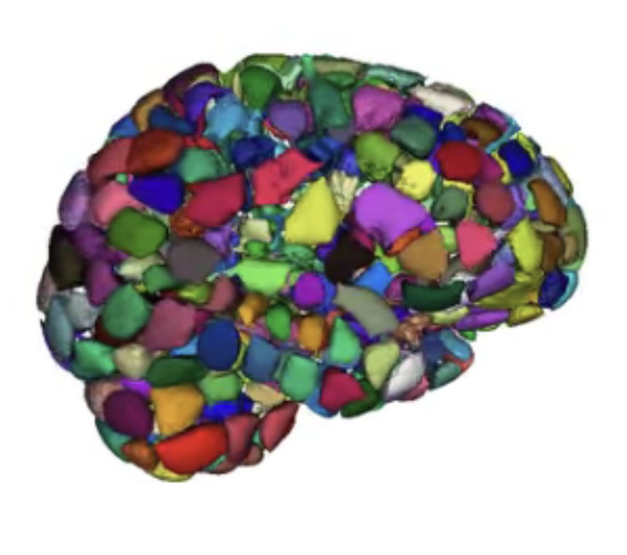
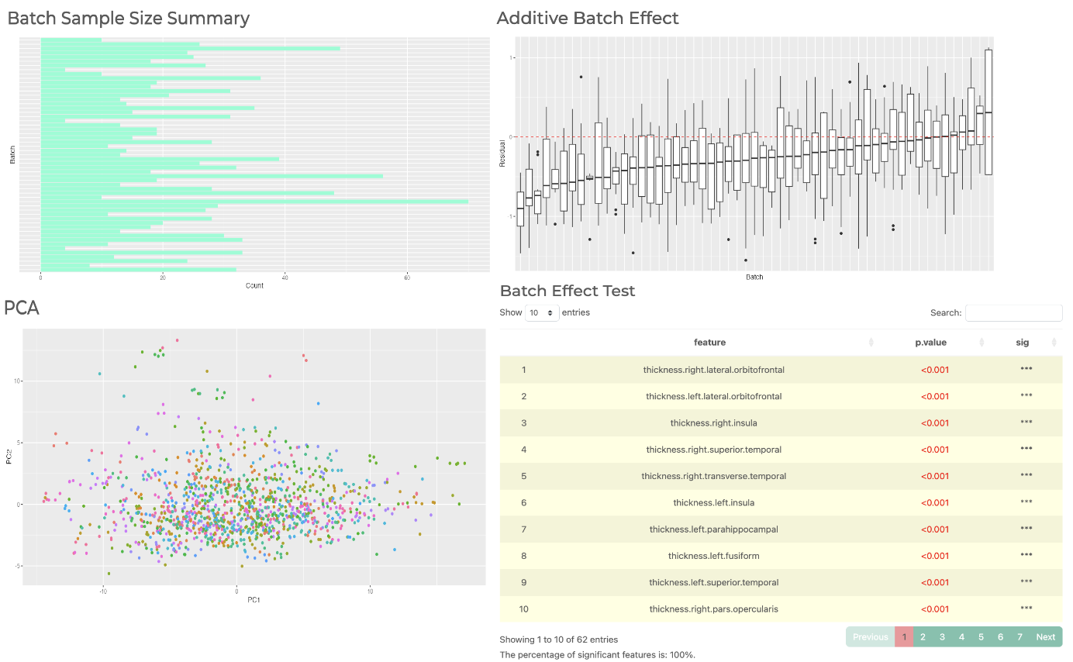
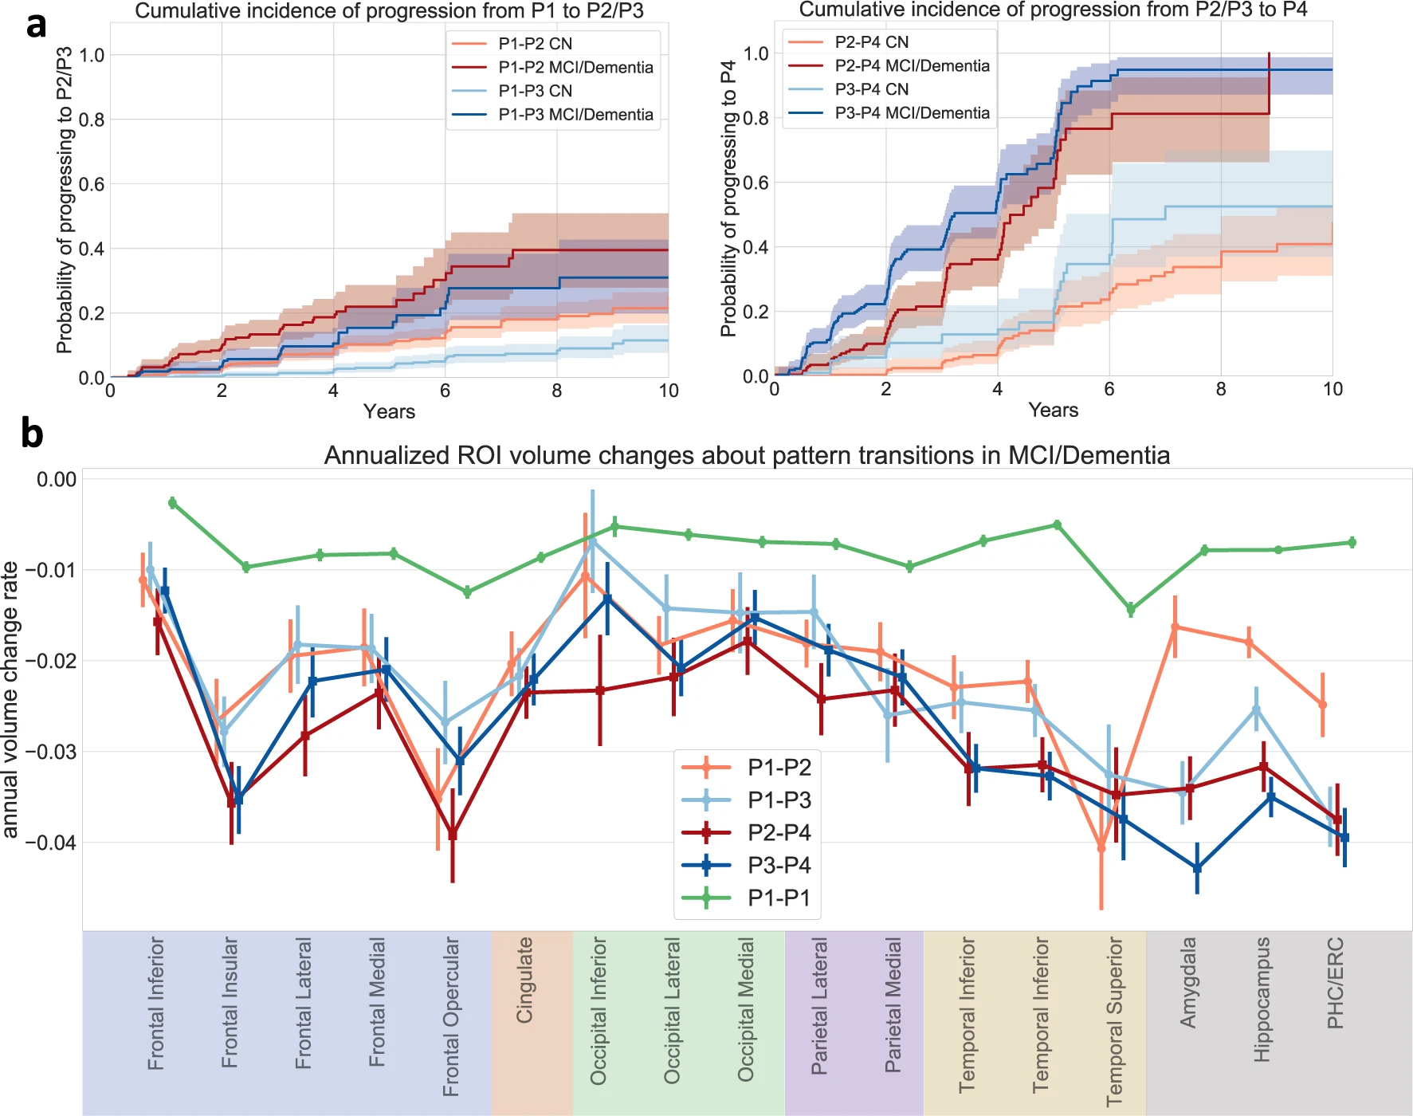
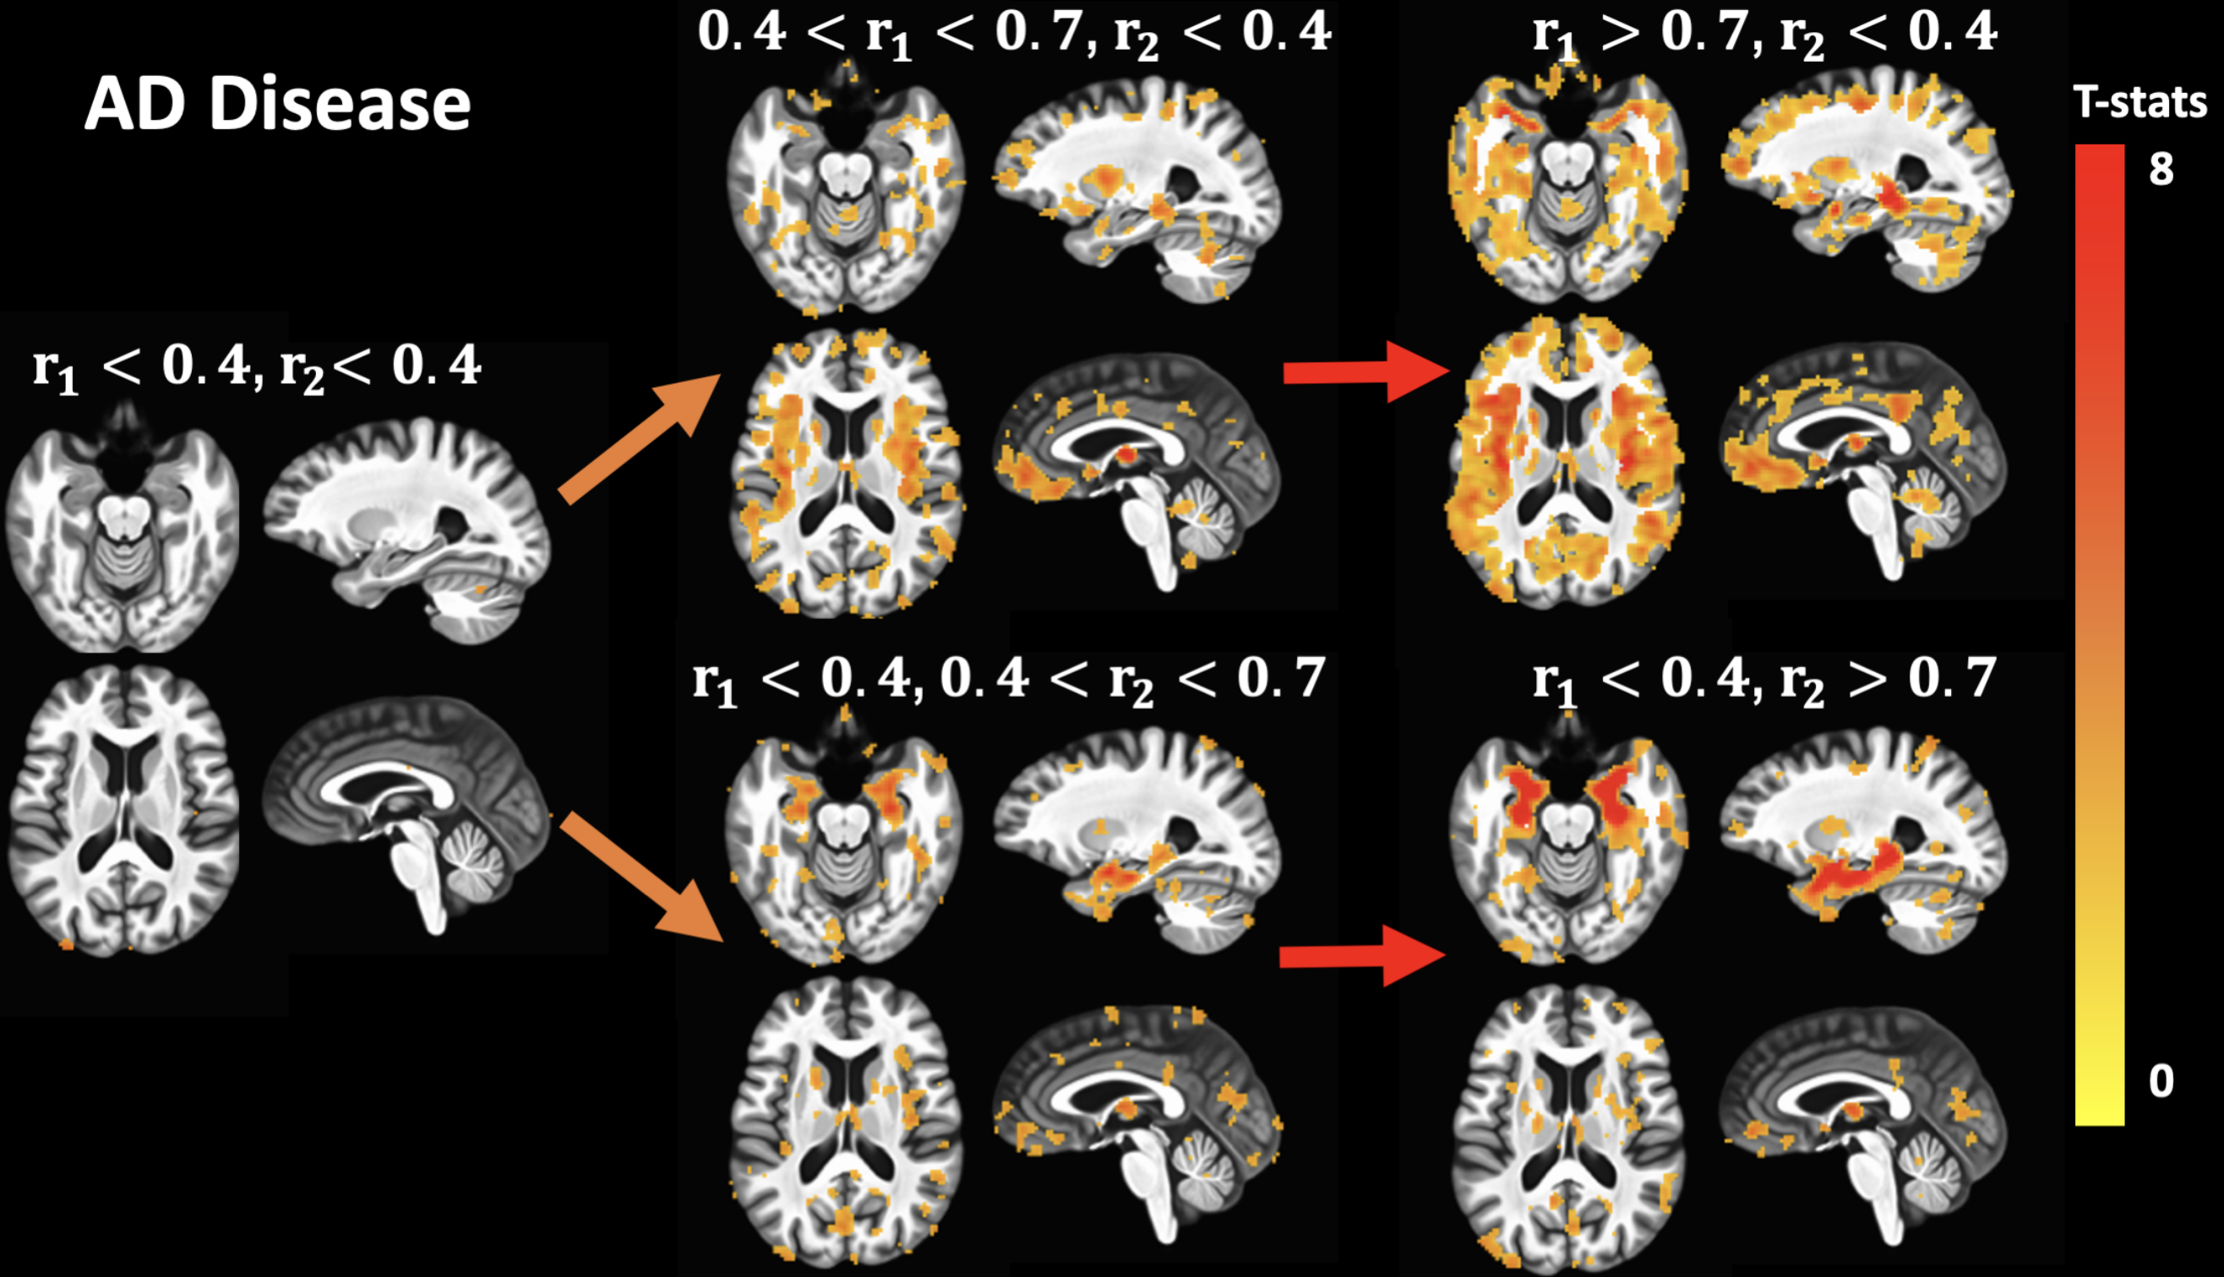
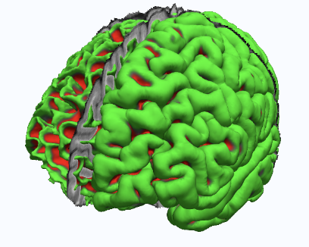
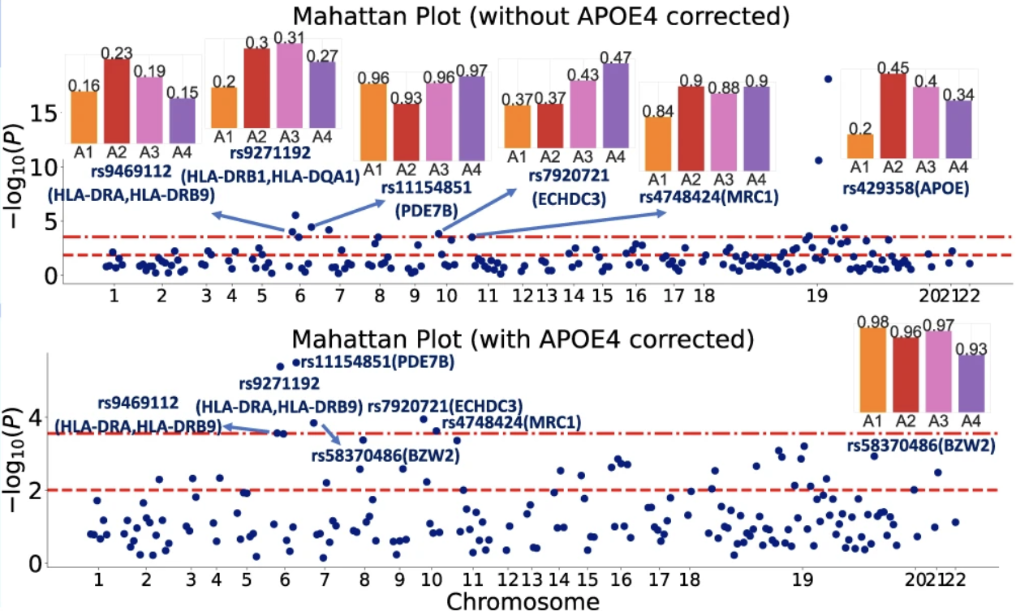
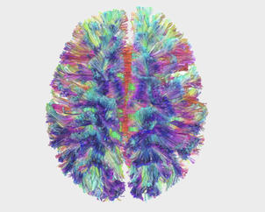
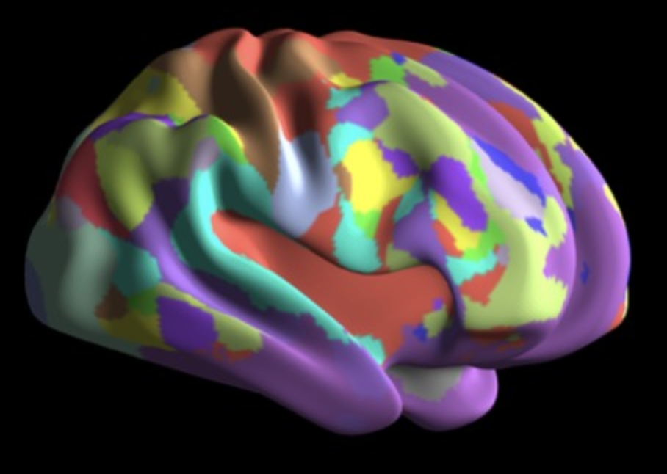
NiChart Software Components
Image Processing
Data Harmonization
Machine Learning
Fast Segmentation of Anatomy and Abnormality
DLICV
Multi-Resolution Structural Covariance Patterns
sopNMF
End-to-end Processing Pipelines for fMRI and DTI Analysis
fMRIPrep
DLMUSE
DLWMLS
XCP-D
DTIPrep
pNet
Estimate and remove scanner-related batch effects in imaging variables:
ComBat
NiChart_Harmonize
Supervised ML models for age and disease prediction:
SPARE-AD
SPARE-BA
SPARE-CVM
Semi-supervised ML models for disease subtype analysis:
SmileGAN
SurrealGAN

Slide 7
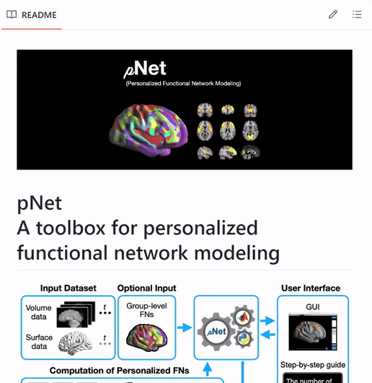
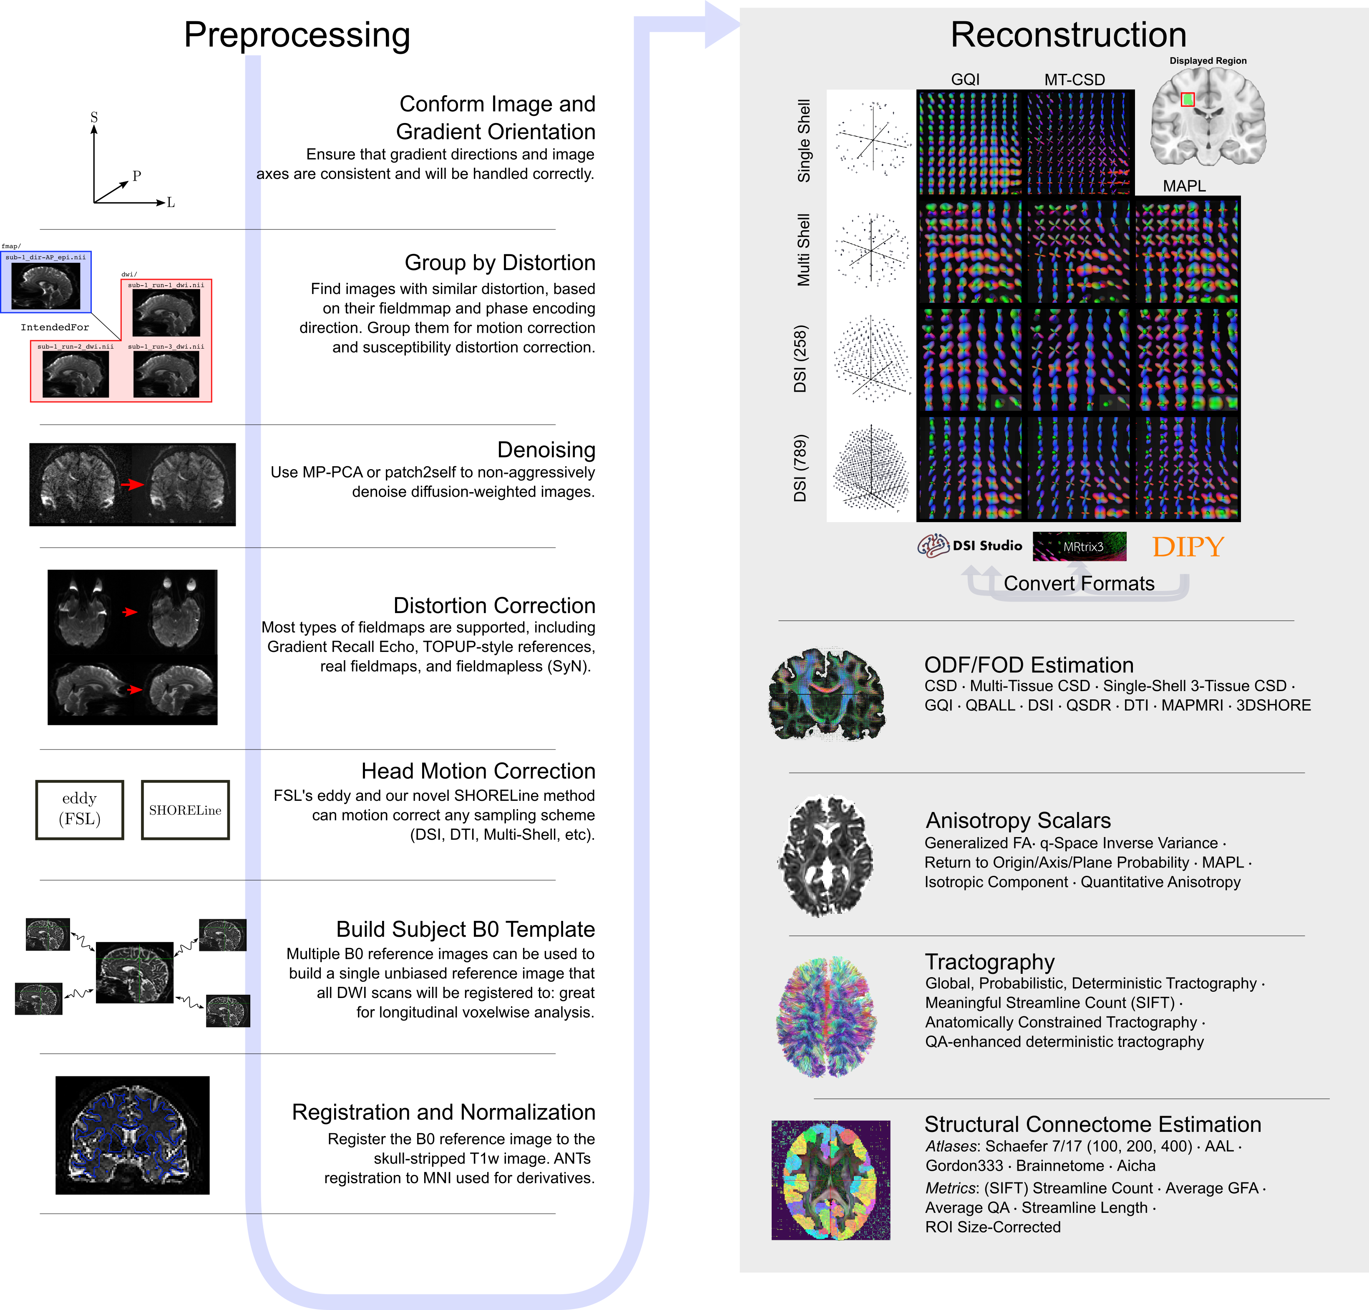
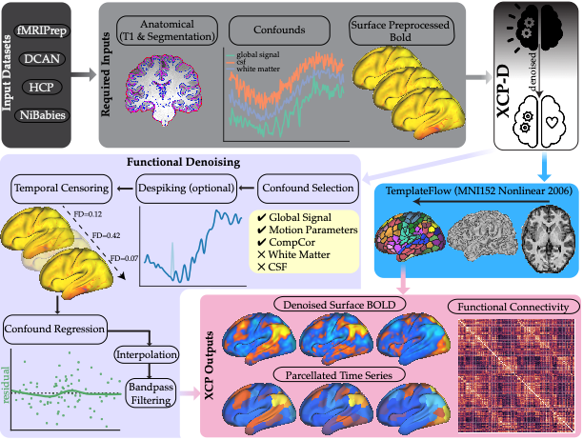
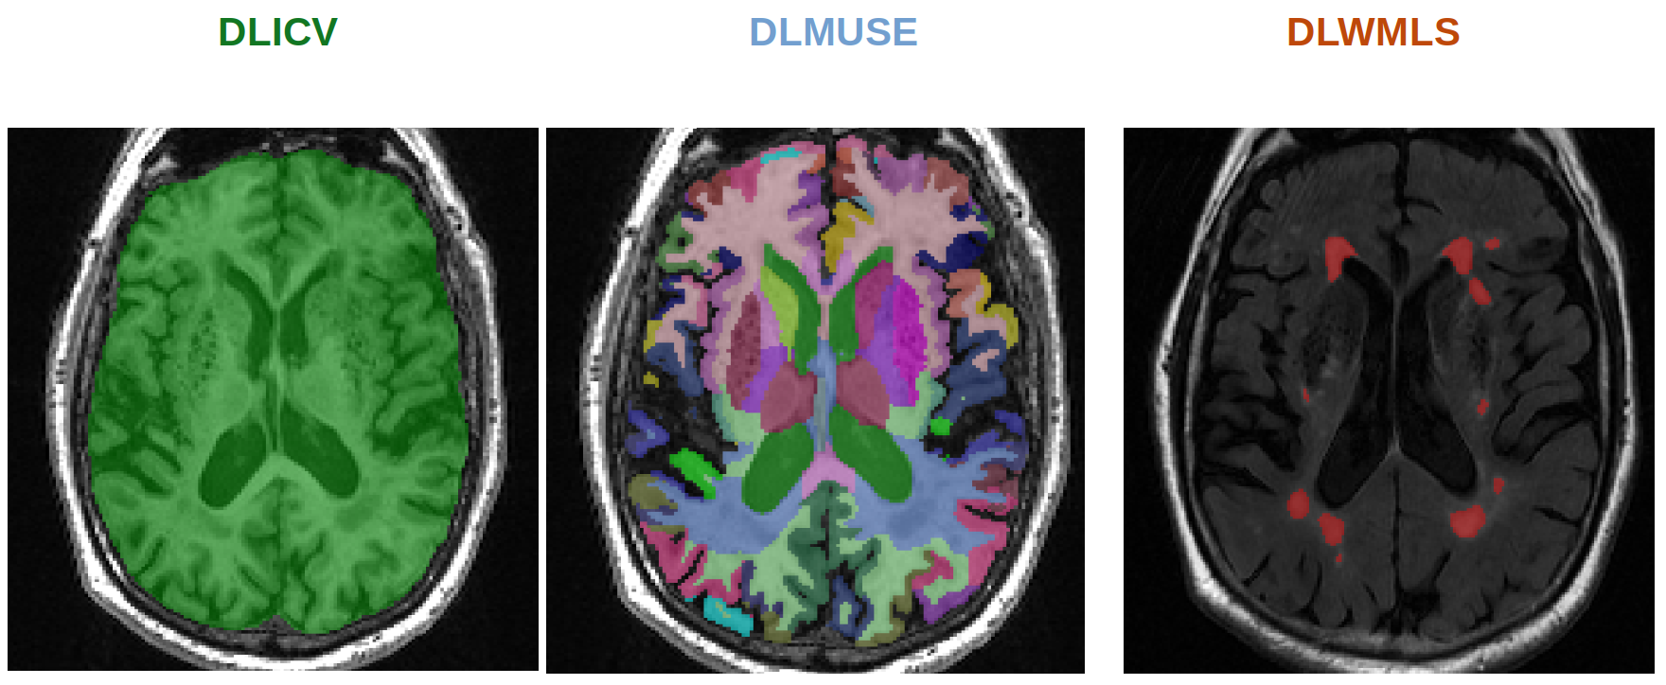
Image Processing
Deep Learning for fast segmentation of anatomy and abnormality for sMRI:
DLICV
DLMUSE
DLWMLS
Multi-resolution structural covariance patterns:
sopNMF
End-to-end processing pipelines for fMRI and DTI analysis:
fMRIPrep
XCP-D
DTIPrep
pNet

Slide 8
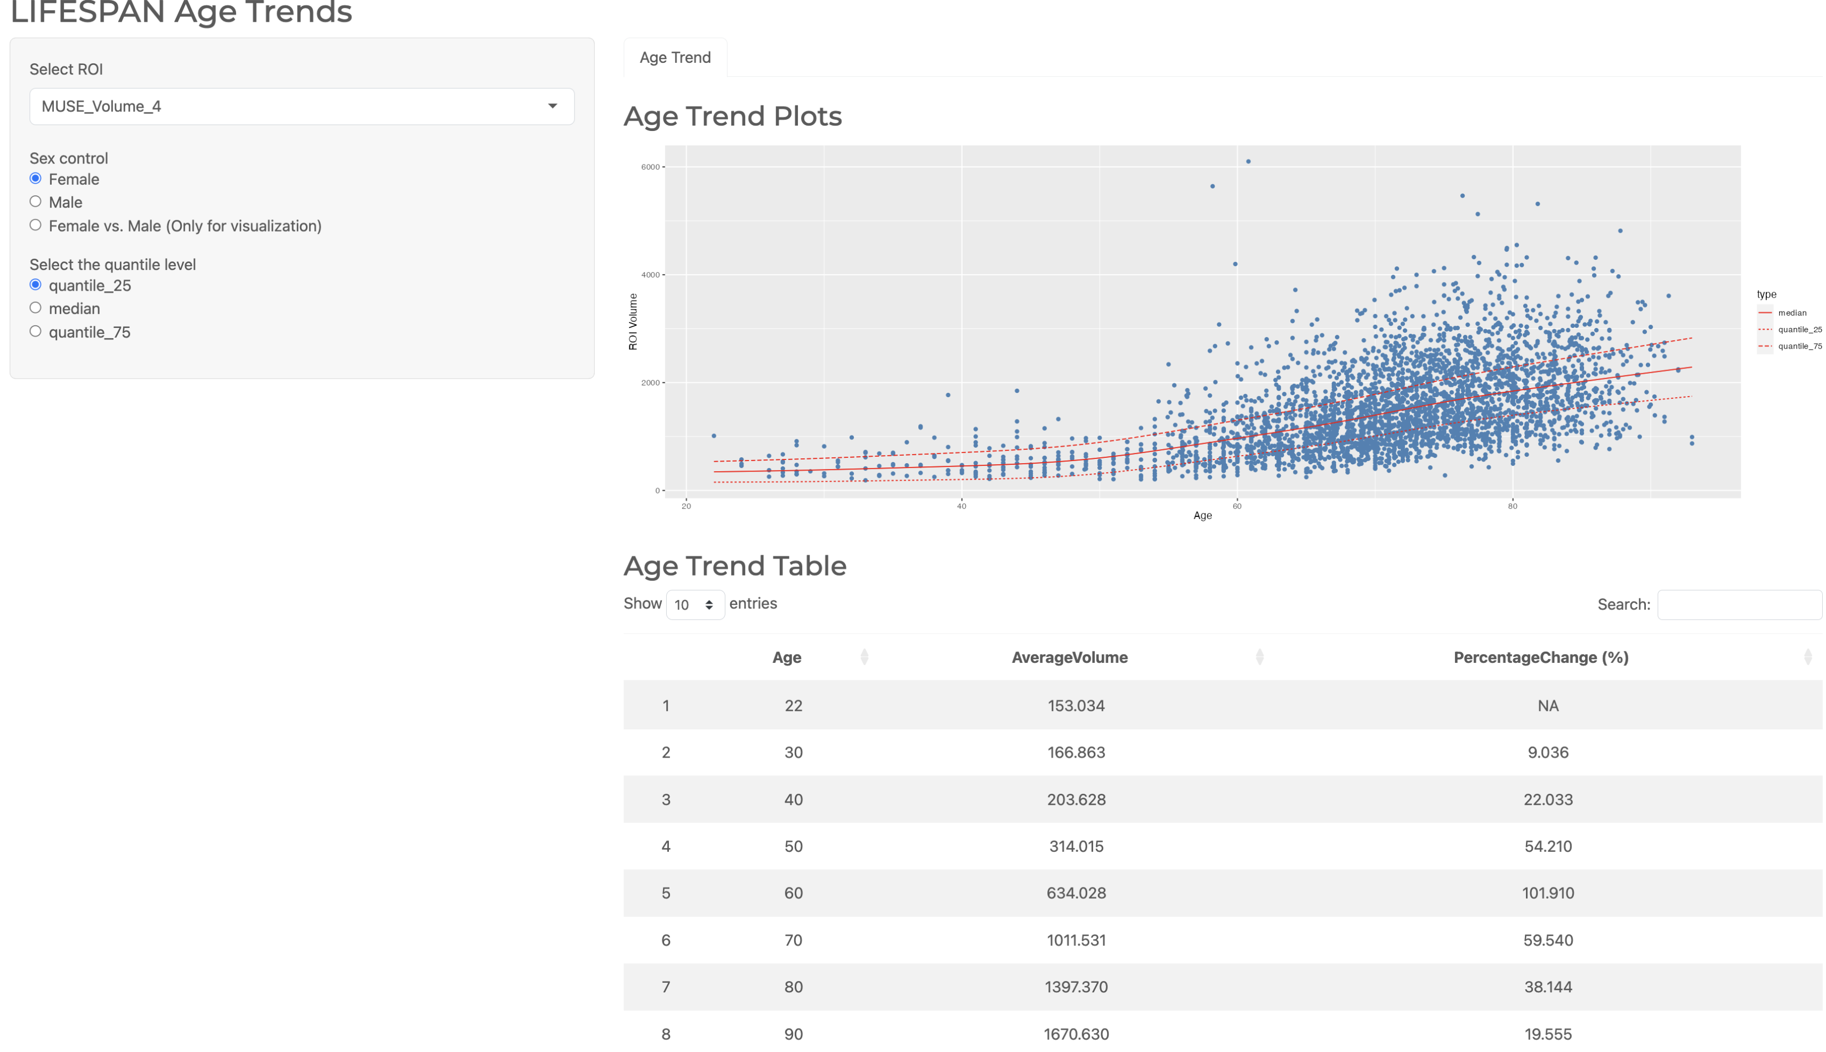
Data Harmonization
First-time Harmonization
Out of sample Harmonization
Harmonize using pre-trained ComBat Model
Original ComBat
ComBat-GAM
Harmonize toward a specific reference dataset
Longitudinal ComBat
CovBat
Interactive Batch Effect Diagnostic
Harmonized Dataset
Unharmonized Dataset
Centile estimates
Post-harmonization Analysis
Harmonization
(First-time & Out of sample)

Slide 9
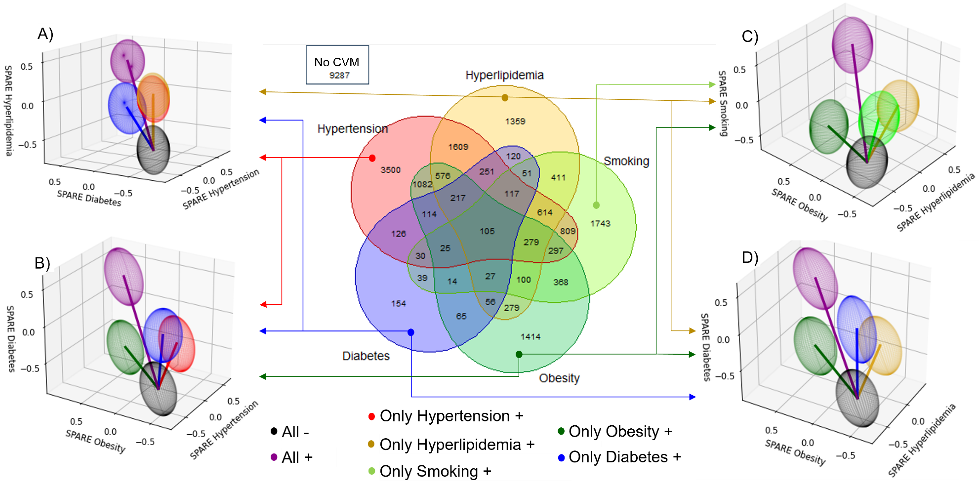
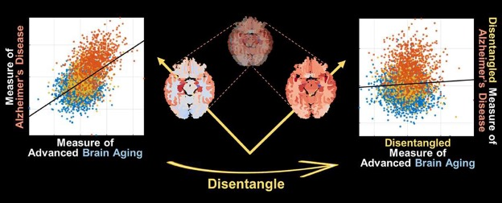
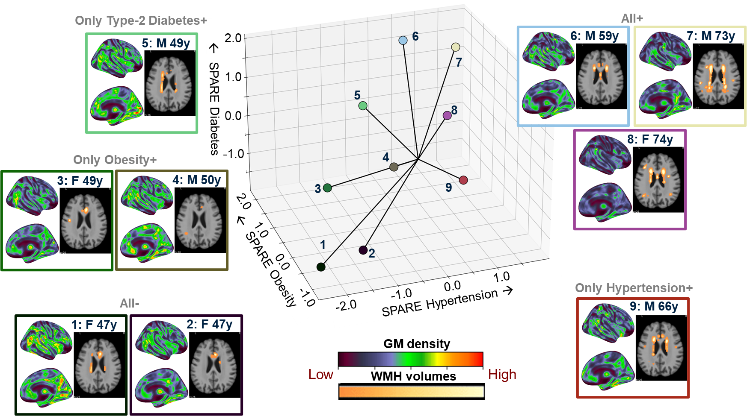
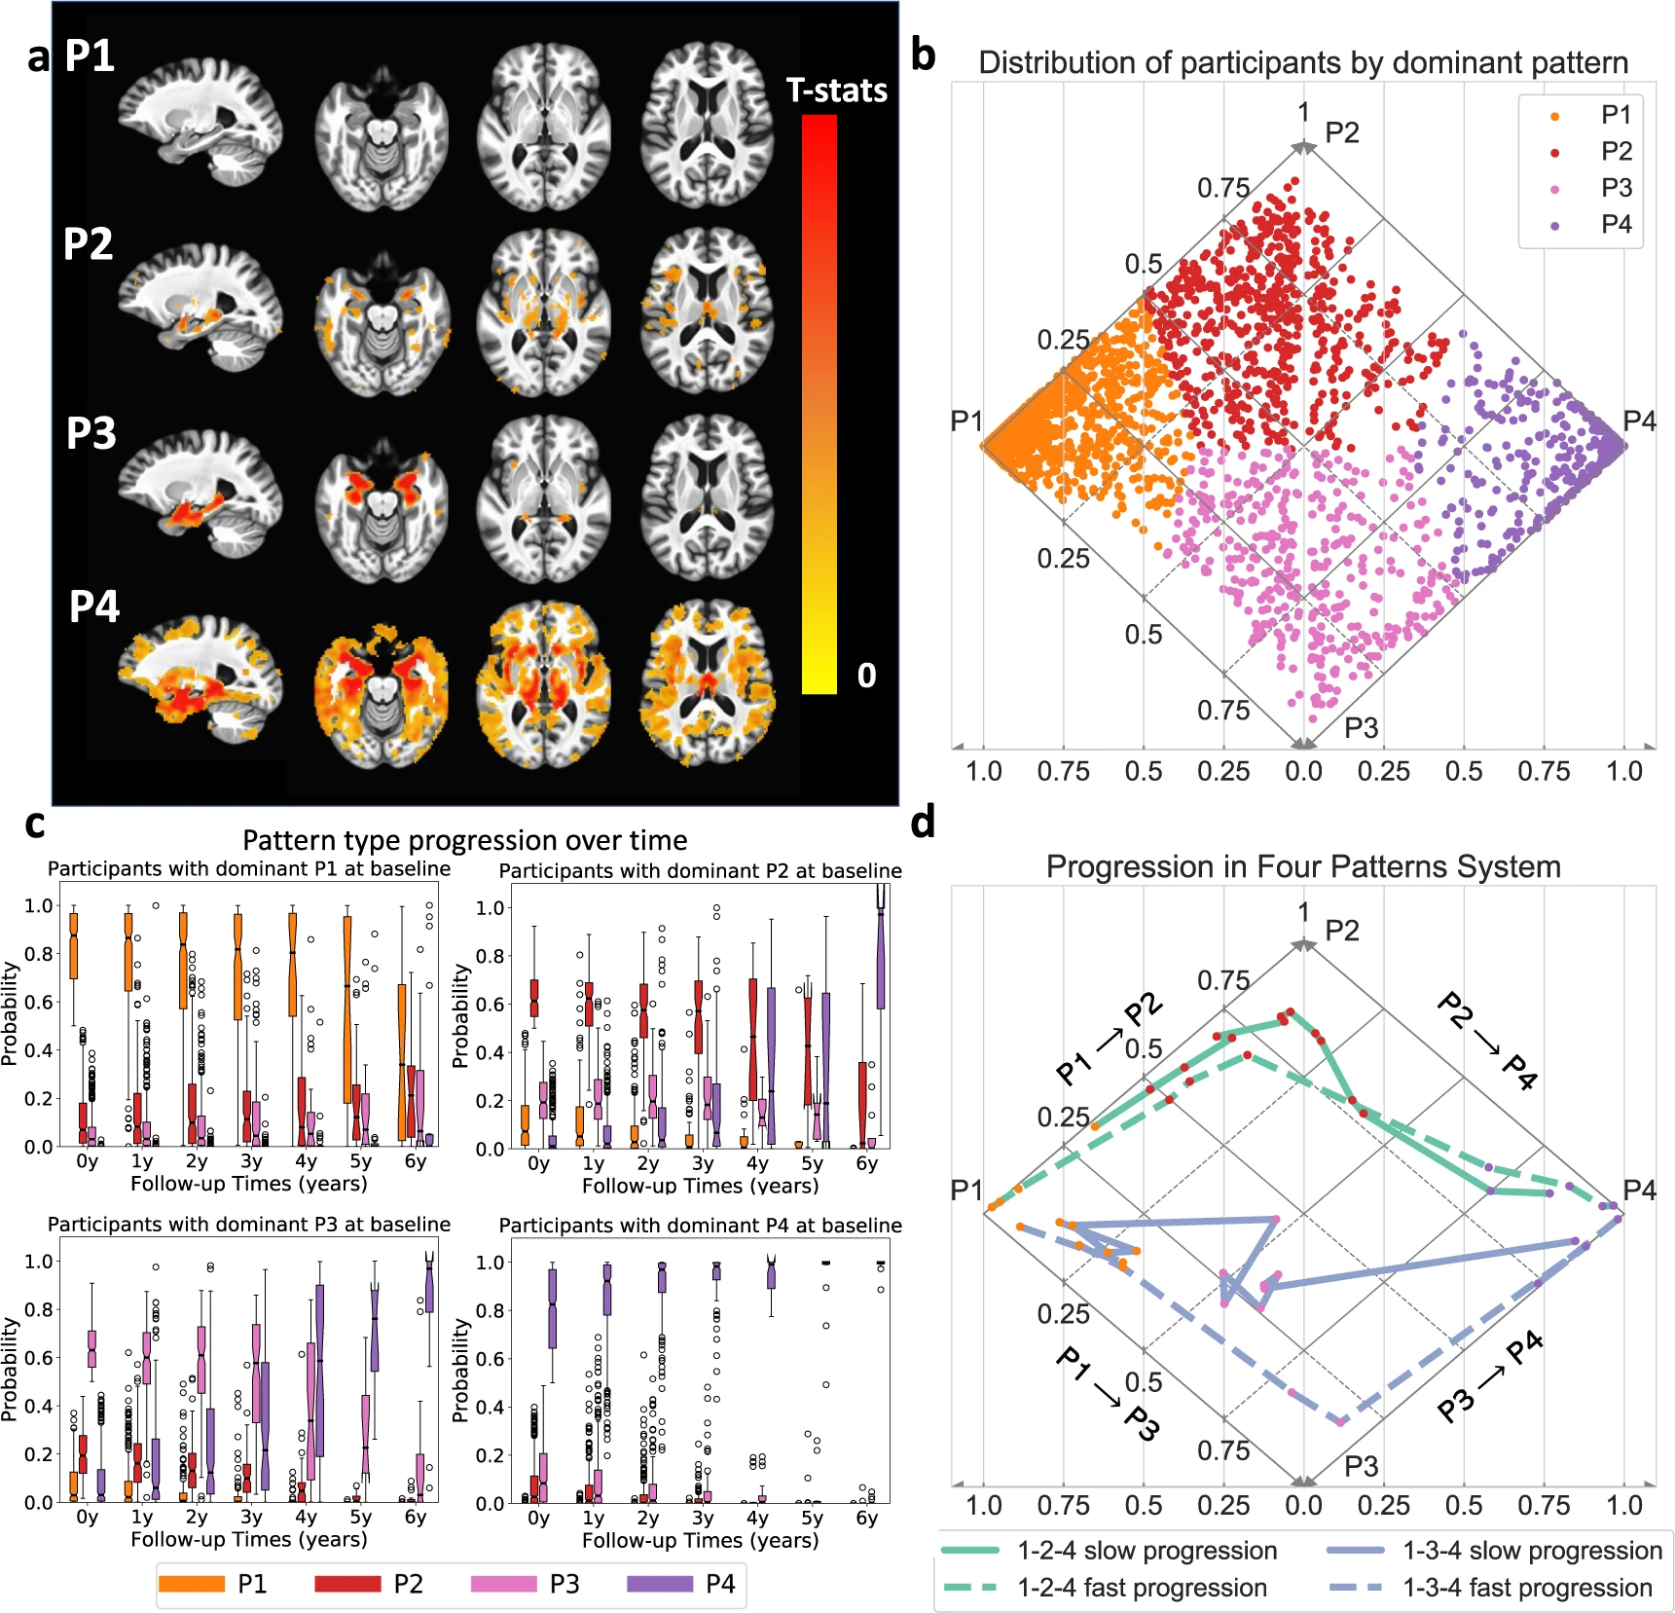
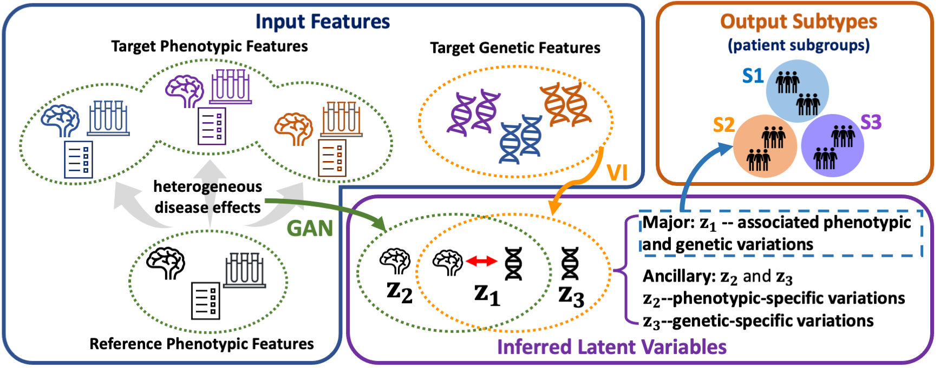
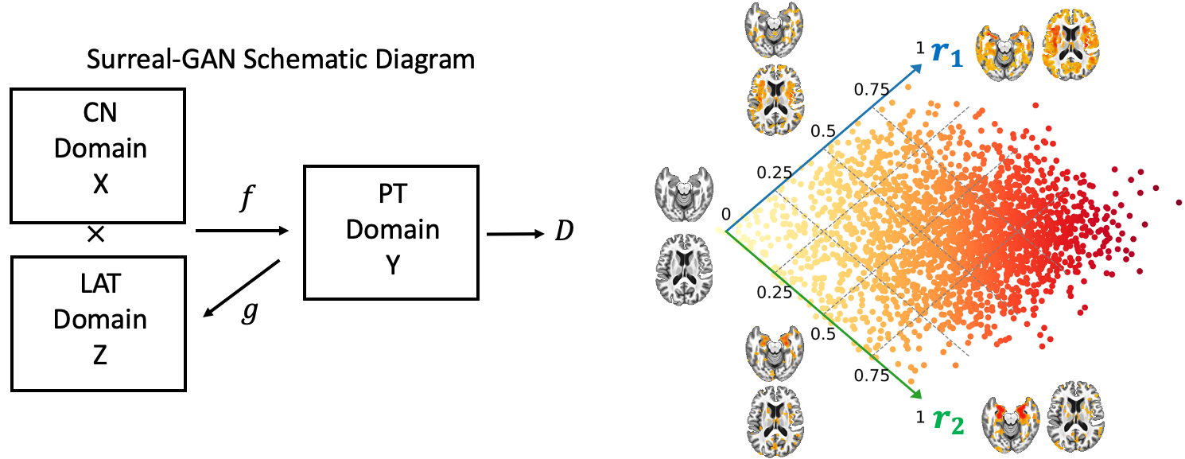
Machine Learning
Supervised ML models for age and disease prediction:
SPARE-AD
SPARE-BA
SPARE-CVM
Semi-supervised ML models for disease subtype analysis:
SmileGAN
SurrealGAN
GeneSGAN
Deep learning models for biomarker extraction from raw images:
DLSPARE
SPARE AD & BA: Graphical Abstract and examples of brain regions associated with typical ageing
SmileGAN: CVM Co-occurrence, SPARE-CVM dimensions Center and Individualized SPARE-CVMs
GeneSGAN: Schematic overview
SmileGAN: Neurodegeneration Atrophy Patterns
SurrealGAN: Schematic diagram

Slide 10
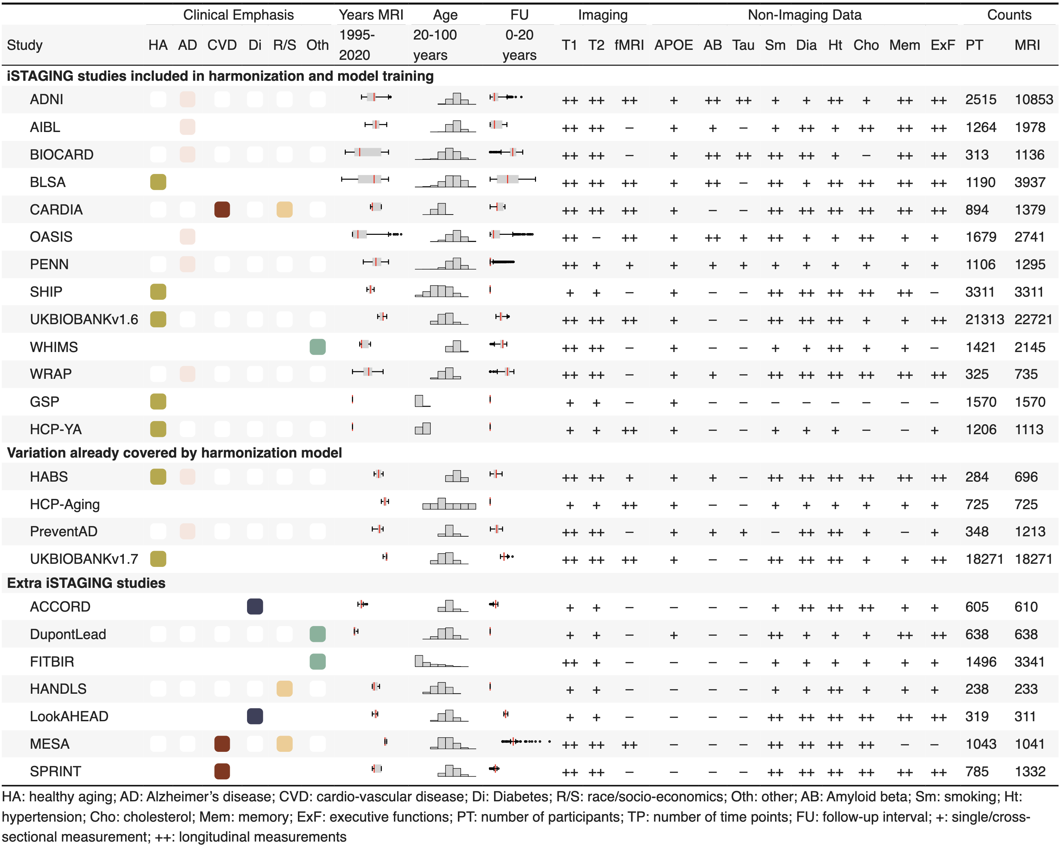
Reference Data Curation
ISTAGING Dataset:
Over 70,000 multi-modal MRI time points across 23 studies.
Rich, curated clinical-cognitive data for disease characterization.
Used for:
Training pipelines for extracting imaging features.
Data harmonization.
Training models for deriving biomarkers.
Normative ranges for visualizations.

Slide 11
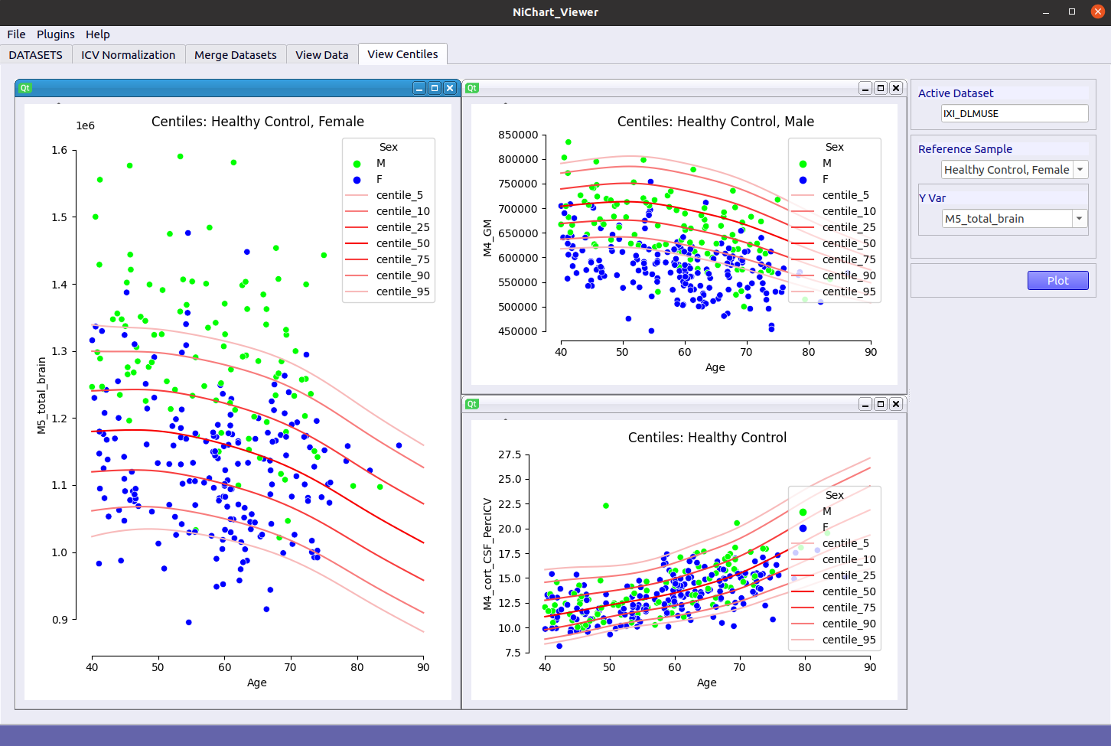
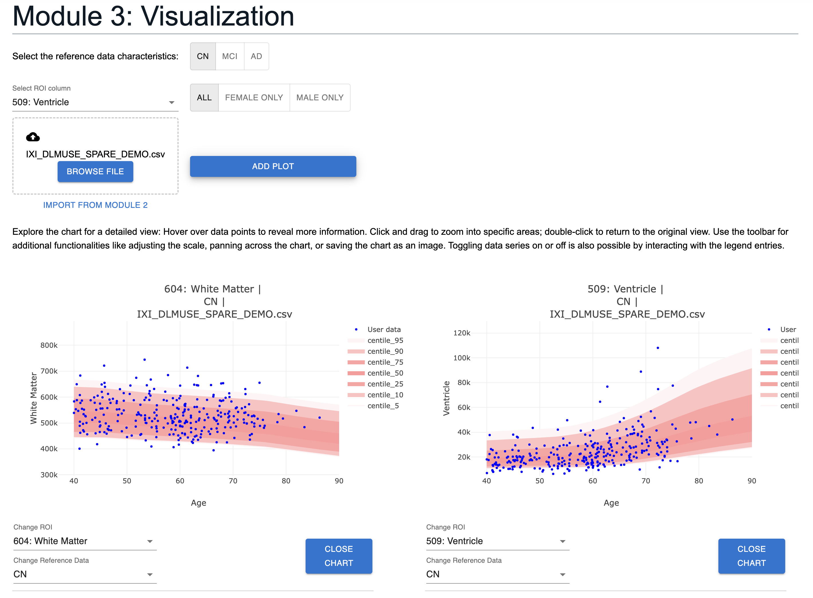
Visualization
PyQT based tool for data visualization:
JavaScript based client-side tool for data visualization on the web:

Slide 12
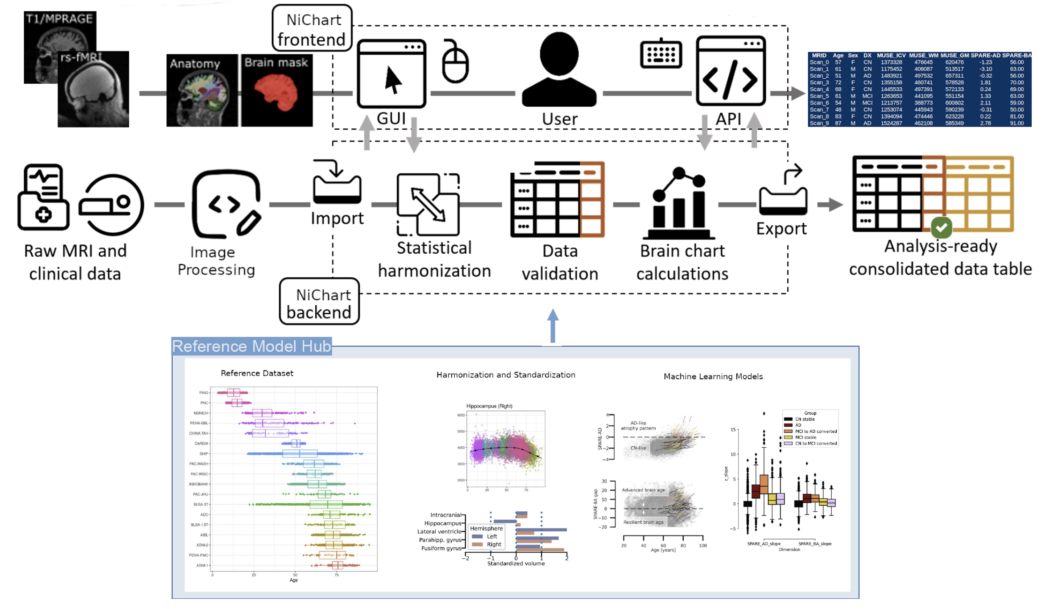
NiChart Architecture

Slide 13
Deployment
Docker & Singularity Containers
AWS – NiChart Cloud Application
https://github.com/CBICA/NiChart_Project
https://hub.docker.com/u/cbica
https://neuroimagingchart.com/
Open-source Packages on GitHub

Slide 14
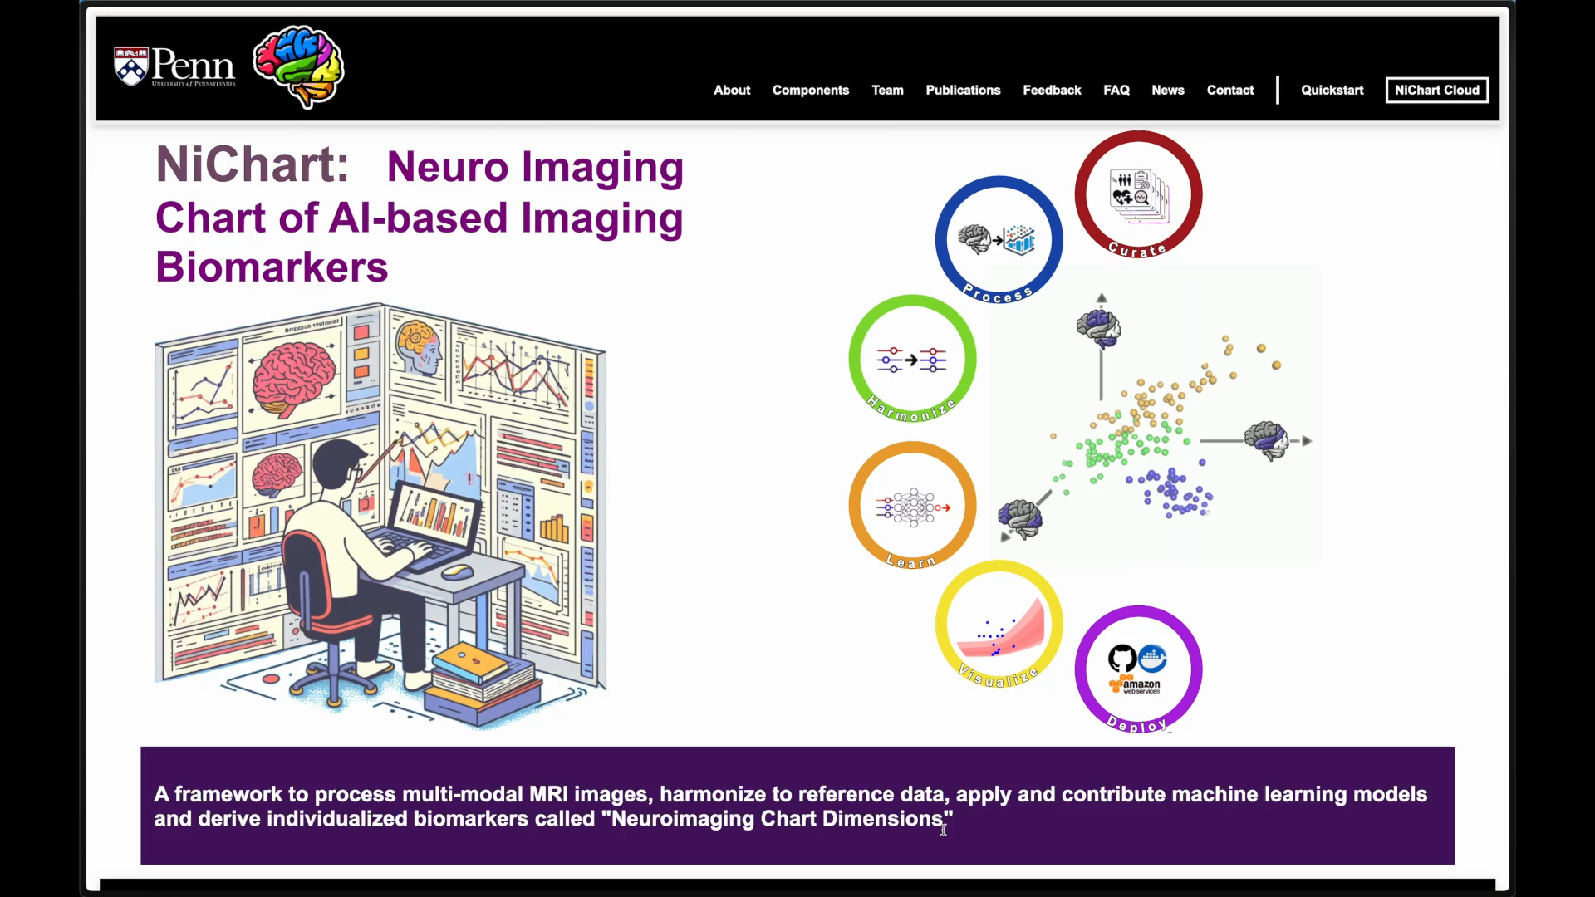
Demo – NiChart Web Portal

Slide 15
Demo – NiChart Locally Installable Packages & Viewer

Slide 16

Participating Labs & Contributors
Artificial Intelligence in Biomedical Imaging Laboratory (AIBIL) ﻿﻿
Lifespan Informatics & Neuroimaging Center (LINC) ﻿﻿
Machine Learning for Biomedical Data Analysis (MLBD) ﻿﻿
Penn Statistics in Imaging and Visualization Endeavor (PennSIVE)
Christos Davatzikos, AIBIL
Russell Shinohara, PennSIVE
Guray Erus, AIBIL
Haochang Shou, PennSIVE
Alexander Getka, AIBIL
Ren Zheng, PennSIVE
George Aidinis, AIBIL
Di Wu, AIBIL
Kyunglok (Kyle) Baik, AIBIL
Yuhan Cui, AIBIL
Dhivya Srinivasan, AIBIL
Mark Bergman, AIBIL
Ilya Nasrallah, AIBIL
Fan Yong, MLBD
Hongming Li, MLBD
Yuncong Ma, MLBD
Theodore Satterthwaite, LINC
Matthew Cieslak, LINC
Taylor Salo, LINC
Daniel Wolf, Penn Psychiatry

Slide 17
Our work

Slide 18
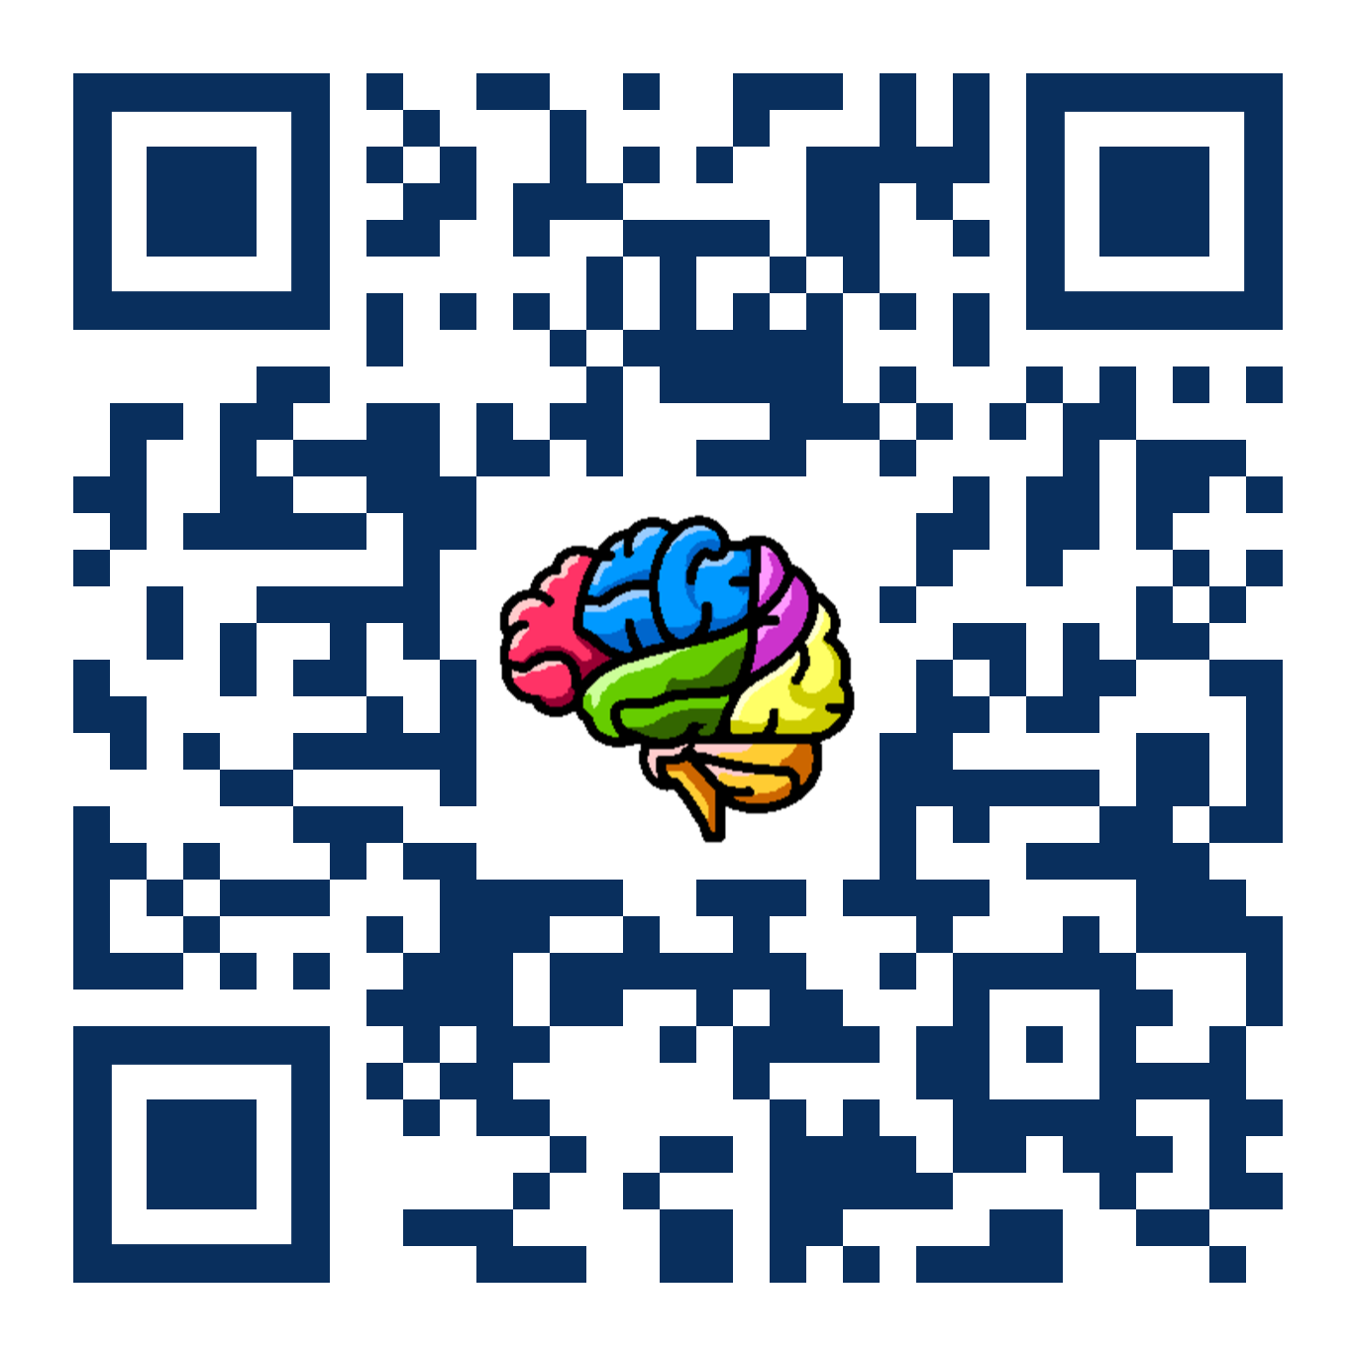


Thank you!
@NiChart_AIBIL
CBICA/NiChart_Project
Grants - Support
The Neuroimaging Brain Chart Software Suite
1U24NS130411-01
National Institutes of Health / National Institute of Neurological Disorders and Stroke

